Slide 1

Gokaraju Rangaraju Institute of Engineering & Technology
Bachupally, Kukatpally, Hyderabad- 500090
DEPARTMENT OF INFORMATION TECHNOLOGY
MINI PROJECT ABSTRACT PRESENTATION
On
SMART HOUSEHOLD AUTOMATION
BATCH NO:12
Name Roll Numbers
1. D Karthik 18241A1275
2. N Sai Sujith 18241A1298
3. J Ganesh 18241A1282
4. G Lokesh Reddy 18241A1281
5. V Sharath 18241A12B7
Under the guidance of
Project Guide
Dr. Ravikiran K
Associate Professor
Head of the Department
Dr. K. Prasanna Lakshmi
Notes:
Post pandemic, everyone are so aware of their surroundings and are trying their best to avoid contact with the things that are used by the people commonly. So, in those common items few of the items are switches in our house

Slide 2





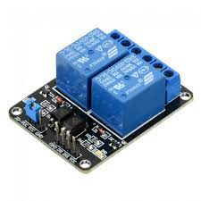



Project Roadmap

Slide 3
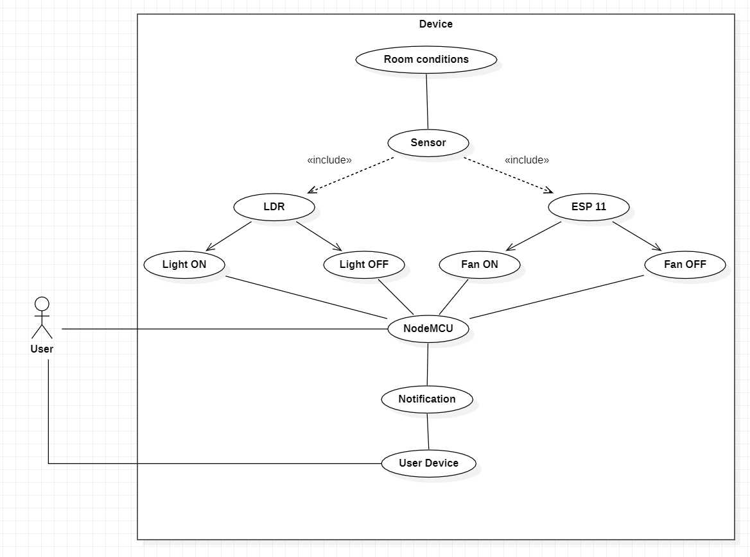

Slide 4
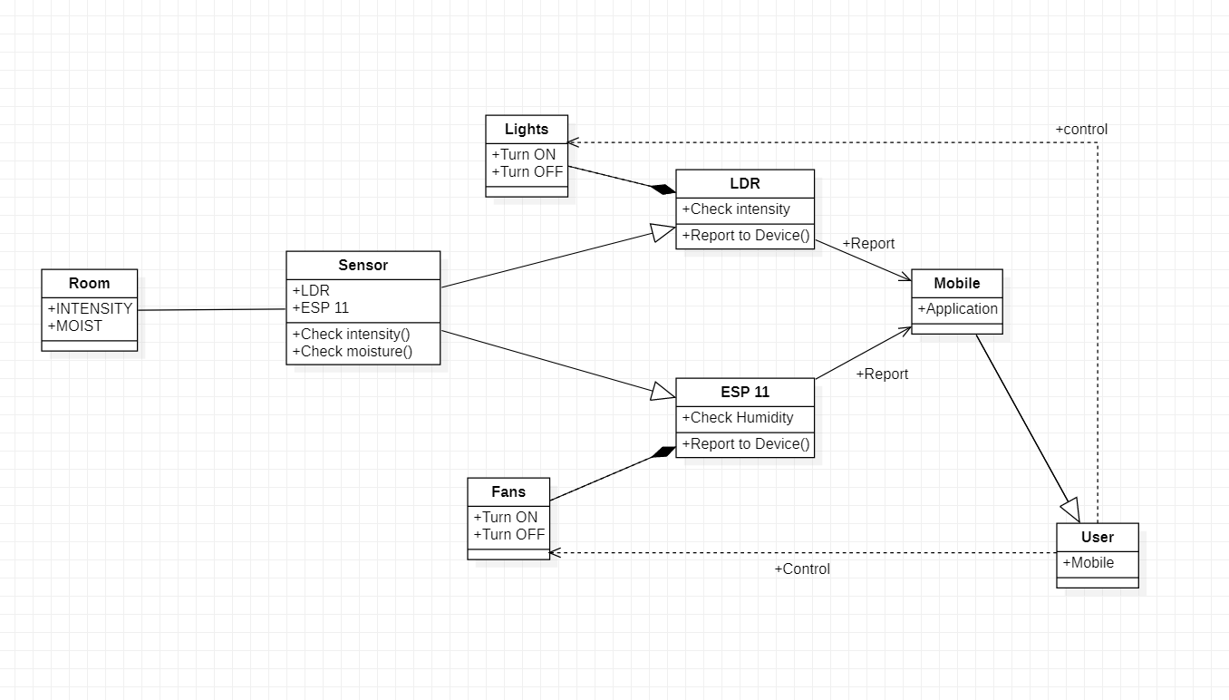

Slide 5
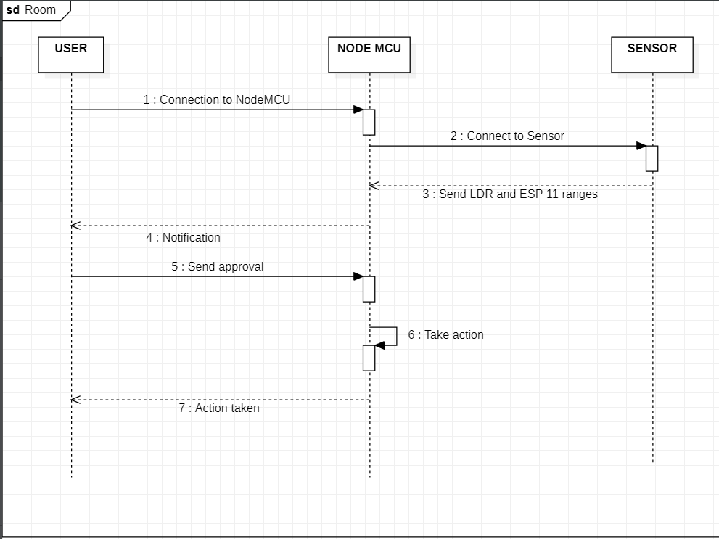

Slide 6
